Slide 1
Credit EDA Case Study (Group Case Study 1)
Prepared by:-
Utkarsh Upadhyay
Mayank Singh Soni

Slide 2
Univariate Analysis

Slide 3
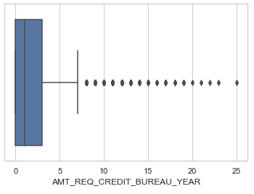
Distribution for AMT_REQ_CREDIT_BUREAU_YEAR
There exist outliers in the AMT_REQ_CREDIT_BUREAU_YEAR variable.
Median lies around 1, so we use mode to impute the missing values

Slide 4
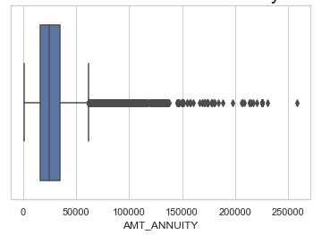
Distribution for Annuity
Plot shows that there are outliers in the AMT_ANNUITY column which is at the extreme end and can be removed from analysis

Slide 5
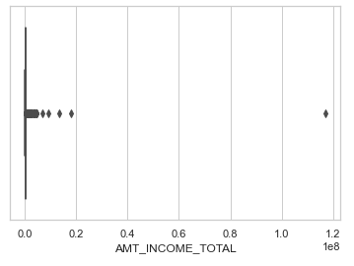
Distribution for Total Income amount
Total Income amount column shows outliers but the income vary from person to person.
We cannot remove this outlier.
It is better to create bins for it.

Slide 6
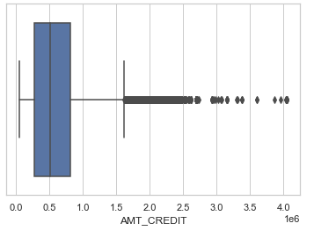
Distribution for Loan Credit Amount
Loan Credit amount column shows outliers but the income vary from person to person.
We cannot remove this outlier.
It is better to create bins for it.

Slide 7
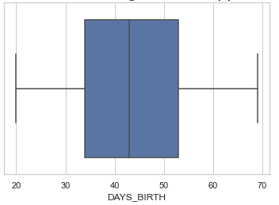
Distribution for Applicant Age
Applicant age data does not have any outliers.
It is well distributed from age 20 to age 70.
Most applicant are fall under age between 35 to 55.
Median lies around age of 43.

Slide 8
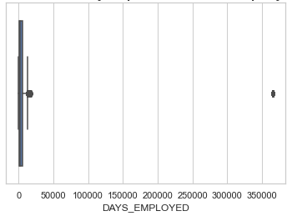
Distribution for applicant’s employed days
There is a outlier whose value is around 360000 days (i.e. 986 years approx.) which is false data. Thus, it needs to be removed.

Slide 9
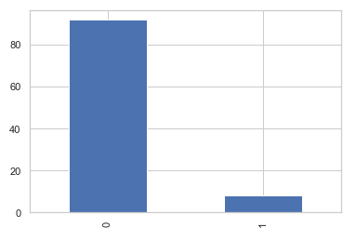
Distribution for target variable
By means of target variable, we can see that approx. 92% people had no difficulty in loan repayment and only 8% people had difficulty in loan repayment.

Slide 10
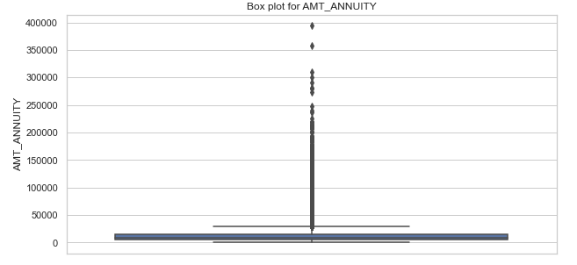
Distribution for previous annuity amount
There are outliers in the previous annuity amount data but annuity amount is also varies from applicant repaying capabilities (High wages/salaried person can afford high annuity amount)
It is better to be capped or binned

Slide 11
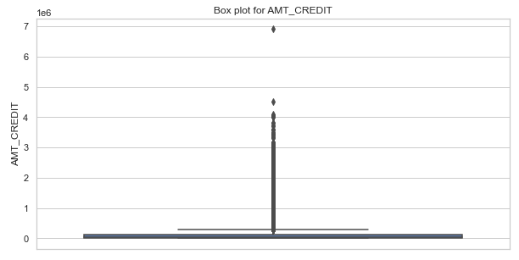
Distribution for previous credit amount
There are outliers in the previous credit amount data but credit amount is also varies from applicant repaying capabilities (High wages/salaried person can afford to high repay amount)
It is better to be capped or binned

Slide 12
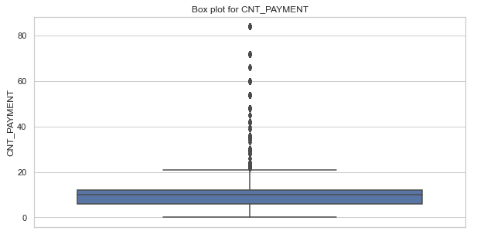
Distribution for previous payment count
There exist outliers in the data.
These are outliers are practically possible as a person can have long term EMIs for low EMI cost.

Slide 13
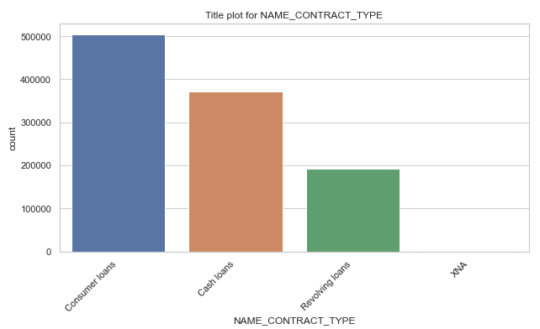
Distribution for Previous Contract Type
Clearly visible that there exist high number of consumers loans as compared to any other loans.

Slide 14
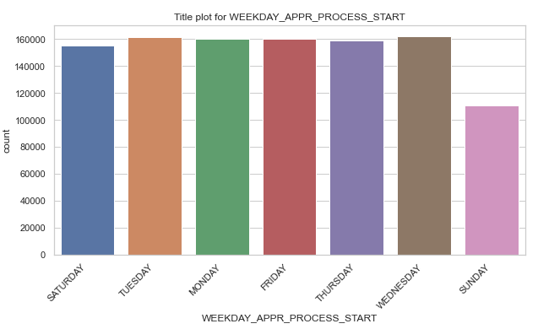
Distribution for
There are less loan application start on Sunday as compared to any other day.
All week days have approximately same numbers of process start.

Slide 15
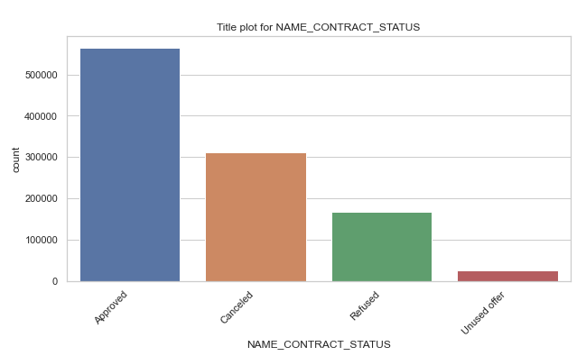
Distribution for previous contract status
There are high number of approved applications in the previous applications dataset.

Slide 16
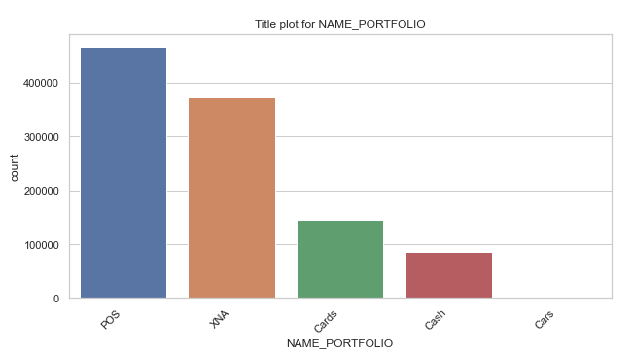
Distribution for previous portfolio
There are high number of POS based portfolio in the previous application dataset.

Slide 17
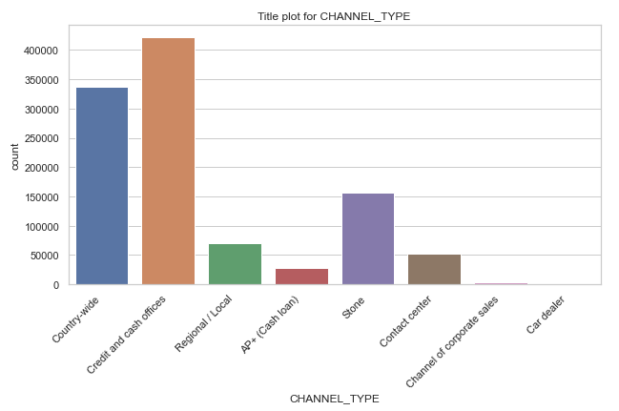
Distribution for previous channel type
There are high number of Credit and cash offices channel type as compared to any other channel.

Slide 18
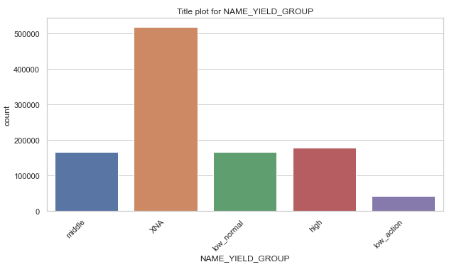
Distribution for previous yield group
There are more number of XNA yield group which can be ignored as it is logical not applicable.
After ignoring XNA, there is high number of high yield group as compared to any other group.

Slide 19
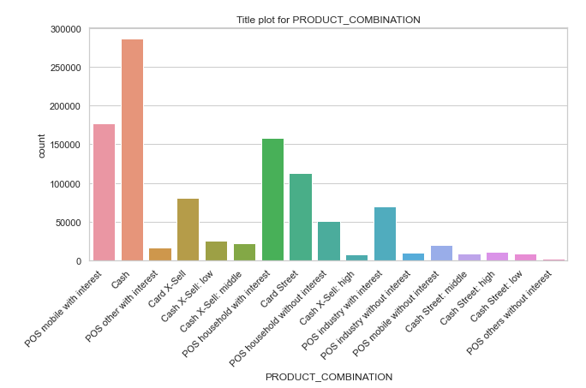
Distribution for
There is

